Slide 1
ENTR 451

Slide 2
Agenda
Review the stories of the different companies
Review the Sales Funnel

Slide 3
Why Use a Sales Funnel?
By quantifying the number of prospects at each stage of the process, you can predict the number of prospects who will, in time, become customers.
You can spot problems in the sales pipeline and take corrective action early.
It shows roadblocks and times of standstill, or if there are an insufficient number of leads at any stage.
This knowledge allows you to determine where sales people should focus attention and efforts to keep sales at the desired level and to meet sales targets.
The funnel can also point out where improvements need to be made within the sales process.

Slide 4
What is a Sales Funnel?
3 types of people you’ll interact with during the sales process:
Leads
Prospects
Customers

Slide 5
Leads
A Lead is someone who becomes aware of your company or someone who you decide to pursue for a sale, even if they don’t know about your company yet
Qualified leads, which are leads that meet certain qualifications to becoming customers.
Who is a qualified lead for your company?

Slide 6
Prospect
Prospect is someone who has had some kind of contact with your company and they are still interested.
All prospects are leads, but not all leads are prospects.

Slide 7
Customers
Customers are people who have made a purchase.
Customers vs. repeat customers

Slide 8
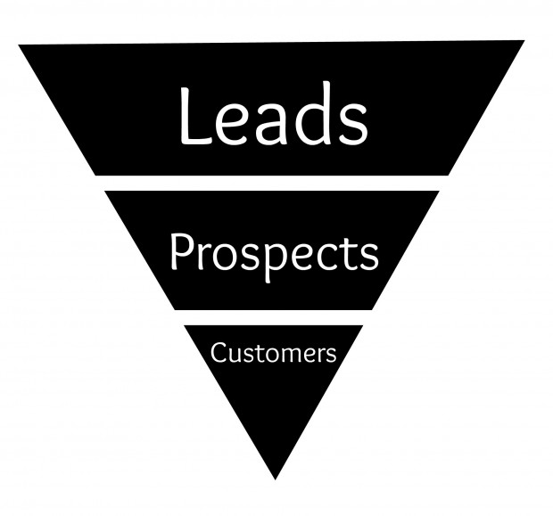
To image a sales funnel, think of an inverted pyramid, or the shape of a kitchen funnel (hence the name). Here’s an example of a very simply sales funnel:

Slide 9
Two Goals
Find more good leads to funnel a larger number of people into the process
Increase the percentage of people who move one level to the next down the pipeline

Slide 10
The Sales Process
Awareness - Social media, email, cold calling, events, advertising, and word of mouth.
Education - why they need your product/service and how it works.
Evaluation – is making a purchase the best option?
Engagement - nudge them closer and closer to making a sale - throw in a bonus for free to offer a limited-time discount.
Commitment - If someone says they intend to buy, it is your job to get that money right away.
Purchase - You can start to celebrate now. You’ve made a sale!
Loyal Fan/Repeat Customer – Tell Someone vs. Buy Again

Slide 11
Finding More Leads
Social Networks – depends on target
Blogging - lead generator through search engine optimization (SEO).
Offer a High-Value Item for Free…Almost
One of the absolute best ways to generate leads is to give away something awesome for free. Instead of paying, ask the person to provide their email address or other contact information.
Cold Calling and Mailers
Tradeshows
Other events – conferences
Guerilla tactics

Slide 12
Turning Leads Into Customers
The real challenge is not in finding new leads, but in moving these leads down the sales funnel and closer to making a purchase.
Moving people down the sales funnel is called lead nurturing
Make your leads feel special. No one likes to feel like a number.
Be extremely helpful. Become an expert in your industry, so you’re seen as an authority.

Slide 13
How to Calculate Sales Funnel Success
Conversion Rate
The conversion rate is the ratio of prospects to conversions. The way you define a conversion (or completed transaction) will be specific to the offer you are making.
Sales funnel success is calculated using sales funnel metrics.

Slide 14
How to Use the Sales Funnel
The first stage in setting up sales funnel reporting is to understand your sales process fully (perhaps using a technique like flowcharting).
Brainstorm the sales process to make sure that it is correct and comprehensive.
From this, identify the key sequential steps in the sales process, and from these, create status codes.
Next, classify your prospects by the status codes you've identified. Finally, work out the number of prospects of each status, and calculate the change since the last month.
INTEGRATE EACH AREA WITH THE MARKETING FUNCTION BASED ON TARGET

Slide 15
Key Metrics
Include number and value of opportunities, close rate and length of sales cycle.
If you monitor your sales funnel velocity, you will be able to more accurately predict your short-term sales.

Slide 16
Sales Funnel Metrics Give You Business Insight
The longer a person is caught in the sales funnel, the less likely you are to convert them into a customer.
Predict the number of qualified opportunities as they flow through your process so that you can forecast sales and new customer acquisition
Calculate how many leads need to be going into your funnel for you to achieve your sales targets easily
Estimate stock levels needed based on sales funnel activity and your conversion rate on leads
Discover how long it takes to convert a qualified lead into a customer. This will definitely help with sales projections and goals

Slide 17
Sales Funnel Metrics Give You Business Insight
Clarify your understanding of where prospects are dropping out in the funnel so that you can step in and recover a relationship or transaction
Observe how changes to the buyer funnel can improve conversion rate
Evaluate the effectiveness of sales funnels so that you can optimize for greater success
Know when are leads most active in a sales funnel, whether that's a time of day, day of the week or time of year
Uncover insights into seasonal buying trends and helps you prepare the business for peaks and troughs in demand for products/services

Slide 18
Groups
What do you perceive your company’s funnel?
How does it fit with the rest of your marketing strategy?

